Slide 1
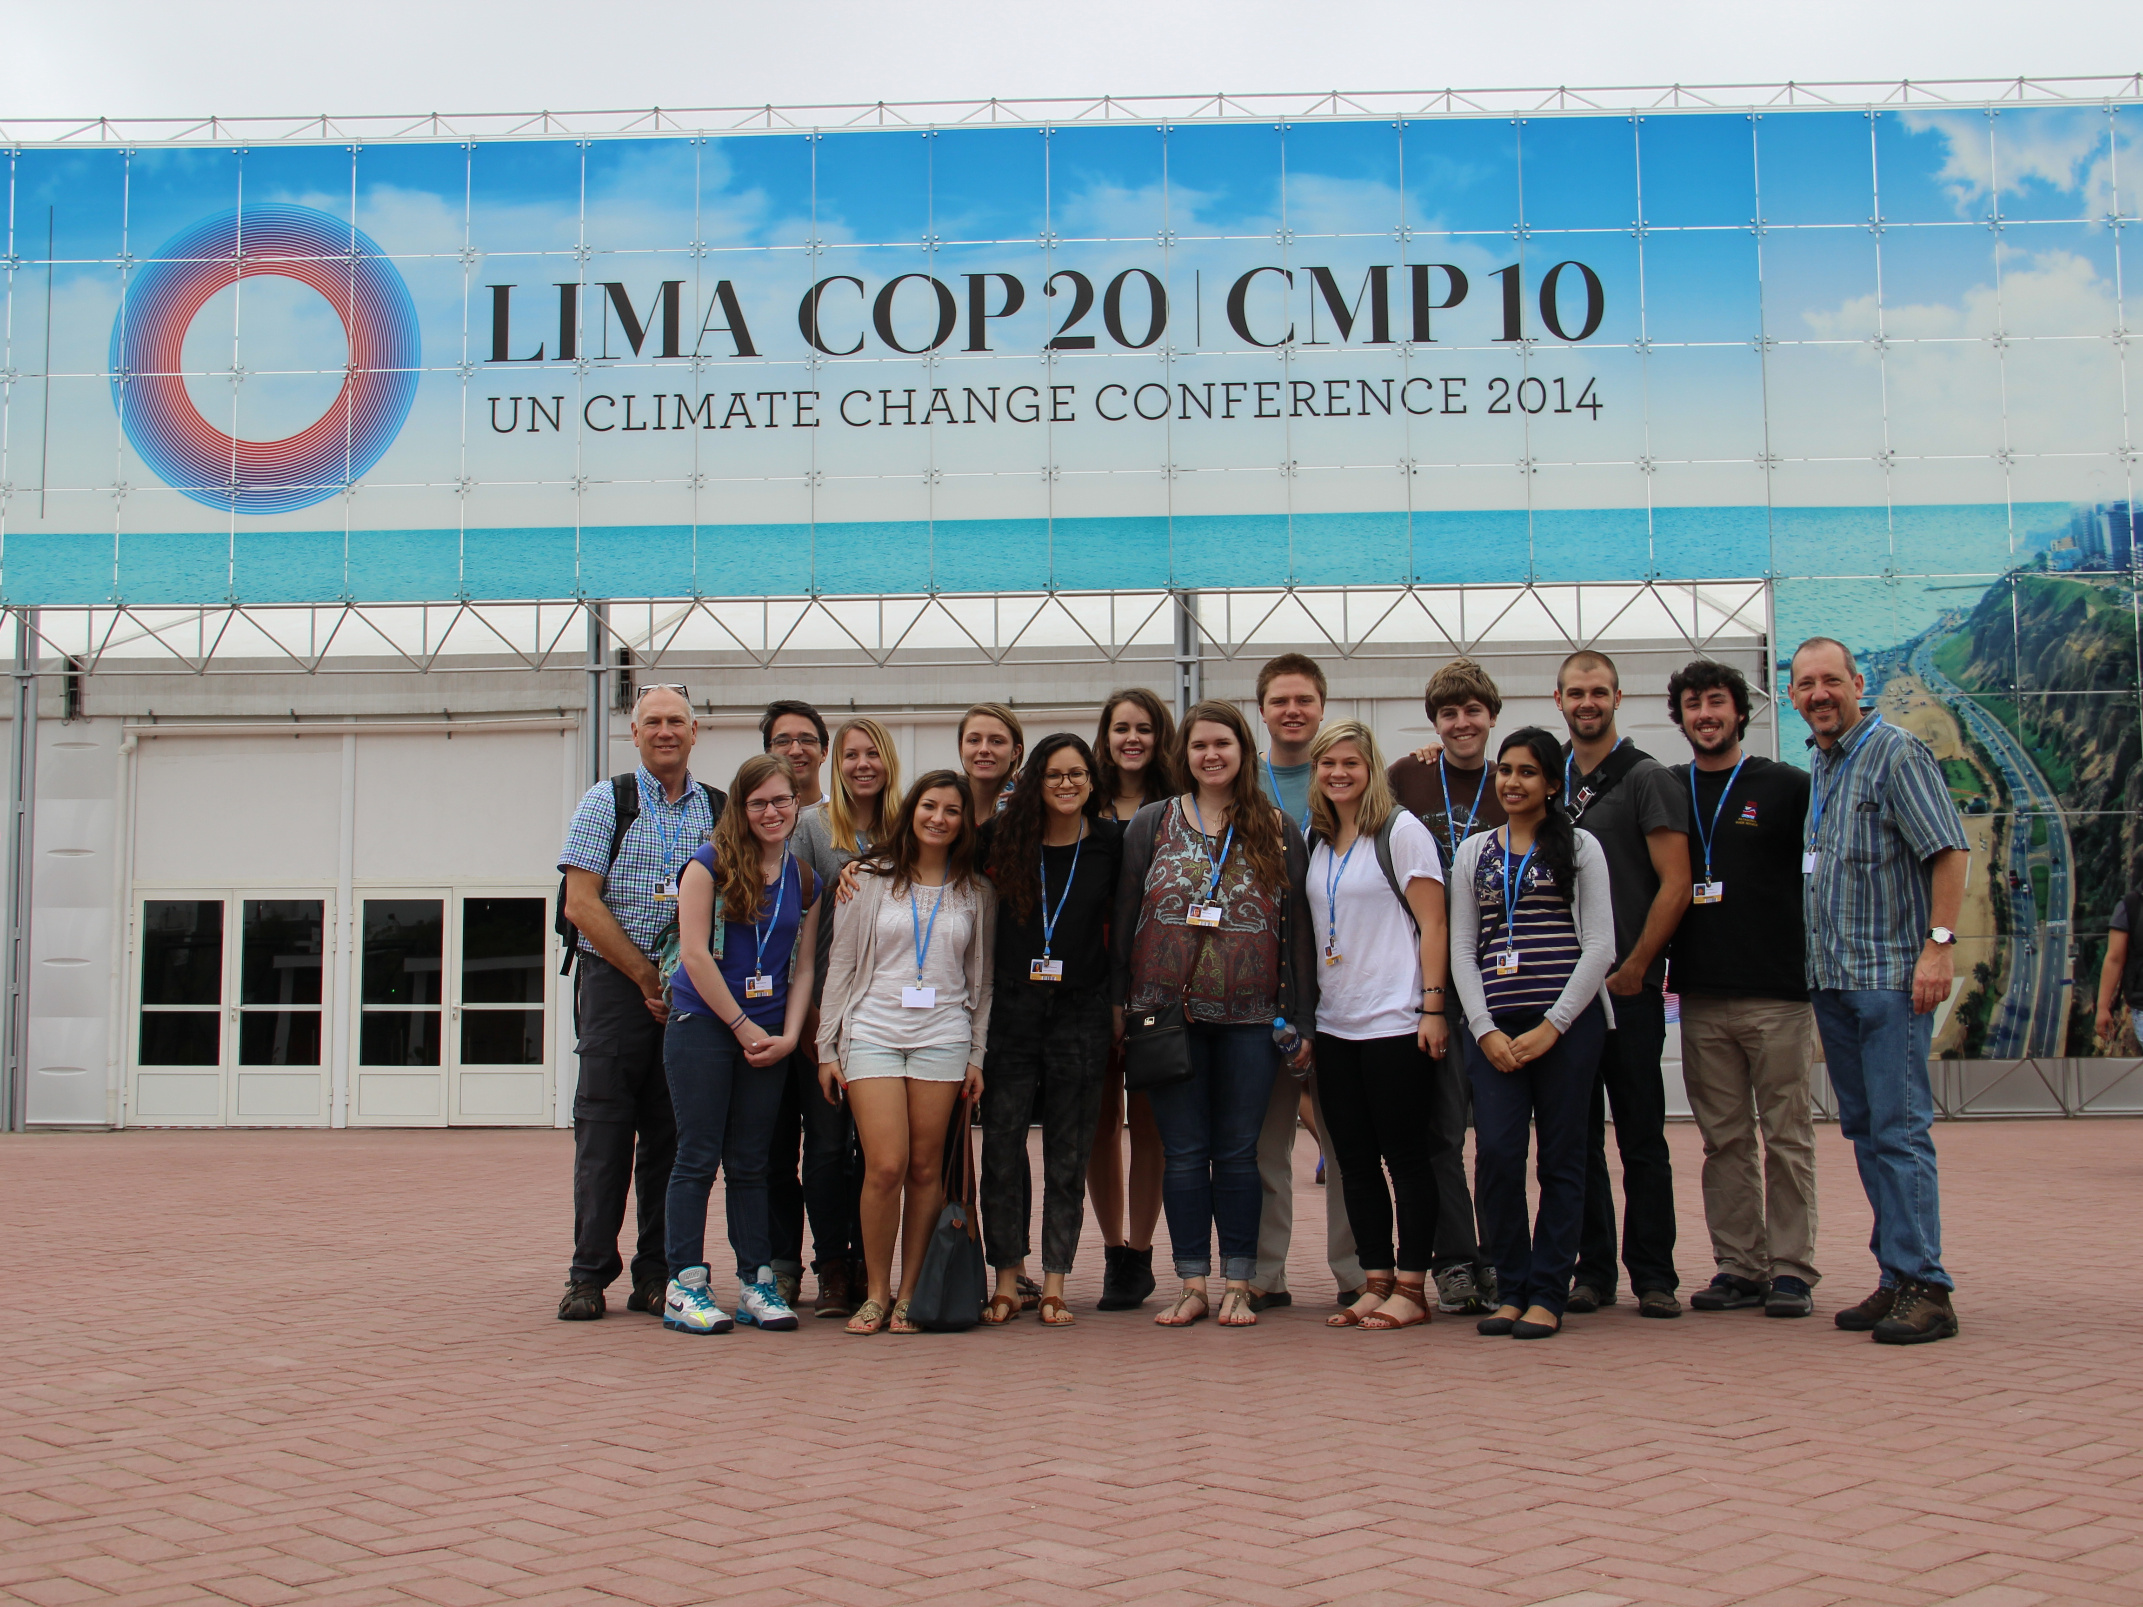
Interpreting the UN Framework Convention on Climate Change
Neil Leary, Dickinson College
Center for Sustainability Education

Slide 2
Global Climate Change Mosaic at Dickinson College, 2014-2015
14 students, 2 instructors
3 courses
  ERSC 204 Global Climate Change
  SUST 330 Global Environmental Challenges & Governance
  SUST 500 Independent Research on Global Climate Change Governance
Field Research at COP20, Lima
SUST 500 course continues into spring semester

Slide 3
Course outline:
Global Environmental Challenges & Governance
Introduction to CC Governance (weeks 1-2)
International Regime, UNFCCC (weeks 3-4)
Beyond Nation States (week 5)
2015 Agreement – Ways Forward (week 6)
Policy Instruments (weeks 7-8)
Dangerous CC, Justice & Sustainable Development (weeks 9-10)
Case studies (weeks 11-12)
Synthesis (week 13)

Slide 4
Paraphrase x 3
Exercise from David Rosenwasser & Jill Stephen, Writing Analytically, 2012
Purposes:
  Discover ideas in a text
  Stimulate interpretation
  Recognize complexities, see potential for multiple interpretations

Slide 5
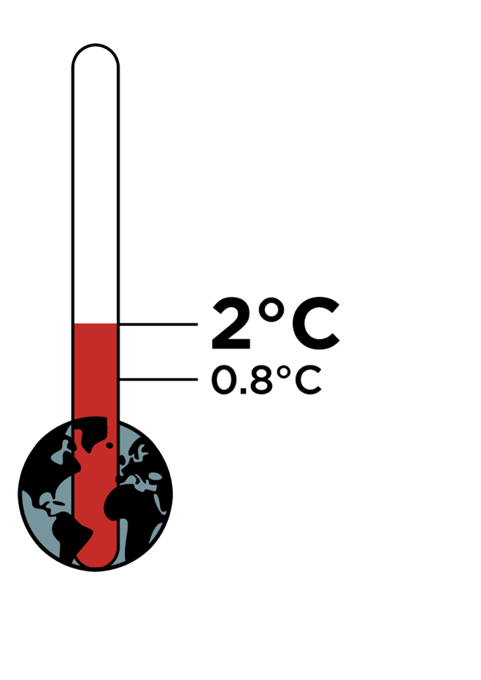
UNFCCC
Objective
  Stabilize GHG concentrations to prevent dangerous climate change
Acknowledges climate change; calls for the widest possible cooperation by all countries
Principles
  Equity: ‘common but differentiated responsibilities and respective capabilities’
  Developed countries should take the lead
  Consideration to developing countries, vulnerable countries
  Precautionary
  Cost effective
  Right to sustainable development

Slide 6
UNFCCC: Paraphrase x 3
Assign each student a passage in the UNFCCC text.
Paraphrase the passage three times.
Contemplate the original and three paraphrased versions
Write an essay:
  What ideas are likely to have shared interpretations?
  What ideas are likely to have contested interpretations?
  What are the implications?

Slide 7
UNFCCC, Article 2
The ultimate objective of this Convention and any related legal instruments that the Conference of the Parties may adopt is to achieve, in accordance with the relevant provisions of the Convention, stabilization of greenhouse gas concentrations in the atmosphere at a level that would prevent dangerous anthropogenic interference with the climate system. Such a level should be achieved within a time-frame sufficient to allow ecosystems to adapt naturally to climate change, to ensure that food production is not threatened and to enable economic development to proceed in a sustainable manner.

Slide 8
UNFCCC, Article 2
The ultimate objective of this Convention and any related legal instruments that the Conference of the Parties may adopt is to achieve, in accordance with the relevant provisions of the Convention, stabilization of greenhouse gas concentrations in the atmosphere at a level that would prevent dangerous anthropogenic interference with the climate system. Such a level should be achieved within a time-frame sufficient to allow ecosystems to adapt naturally to climate change, to ensure that food production is not threatened and to enable economic development to proceed in a sustainable manner.

Slide 9
UNFCCC, Article 2
The ultimate objective of this Convention and any related legal instruments that the Conference of the Parties may adopt is to achieve, in accordance with the relevant provisions of the Convention, stabilization of greenhouse gas concentrations in the atmosphere at a level that would prevent dangerous anthropogenic interference with the climate system. Such a level should be achieved within a time-frame sufficient to allow ecosystems to adapt naturally to climate change, to ensure that food production is not threatened and to enable economic development to proceed in a sustainable manner.

Slide 10
UNFCCC, Article 2
The ultimate objective of this Convention and any related legal instruments that the Conference of the Parties may adopt is to achieve, in accordance with the relevant provisions of the Convention, stabilization of greenhouse gas concentrations in the atmosphere at a level that would prevent dangerous anthropogenic interference with the climate system. Such a level should be achieved within a time-frame sufficient to allow ecosystems to adapt naturally to climate change, to ensure that food production is not threatened and to enable economic development to proceed in a sustainable manner.

Slide 11
UNFCCC, Article 2
The ultimate objective of this Convention and any related legal instruments that the Conference of the Parties may adopt is to achieve, in accordance with the relevant provisions of the Convention, stabilization of greenhouse gas concentrations in the atmosphere at a level that would prevent dangerous anthropogenic interference with the climate system. Such a level should be achieved within a time-frame sufficient to allow ecosystems to adapt naturally to climate change, to ensure that food production is not threatened and to enable economic development to proceed in a sustainable manner.

Slide 12
UNFCCC, Article 2
The ultimate objective of this Convention and any related legal instruments that the Conference of the Parties may adopt is to achieve, in accordance with the relevant provisions of the Convention, stabilization of greenhouse gas concentrations in the atmosphere at a level that would prevent dangerous anthropogenic interference with the climate system. Such a level should be achieved within a time-frame sufficient to allow ecosystems to adapt naturally to climate change, to ensure that food production is not threatened and to enable economic development to proceed in a sustainable manner.

Slide 13
UNFCCC, Article 2
The ultimate objective of this Convention and any related legal instruments that the Conference of the Parties may adopt is to achieve, in accordance with the relevant provisions of the Convention, stabilization of greenhouse gas concentrations in the atmosphere at a level that would prevent dangerous anthropogenic interference with the climate system. Such a level should be achieved within a time-frame sufficient to allow ecosystems to adapt naturally to climate change, to ensure that food production is not threatened and to enable economic development to proceed in a sustainable manner.

Slide 14
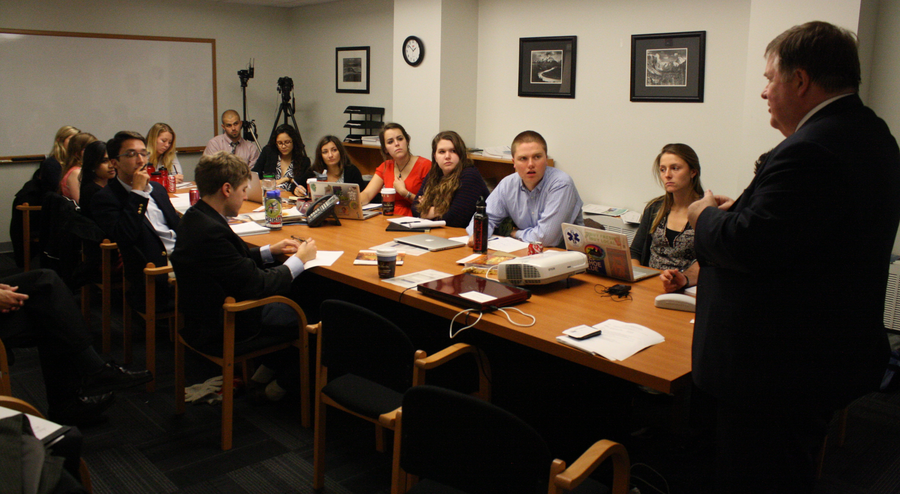
Meetings with policymakers and NGO leaders, offices of National Council for Science and the Environment (NCSE)

Slide 15
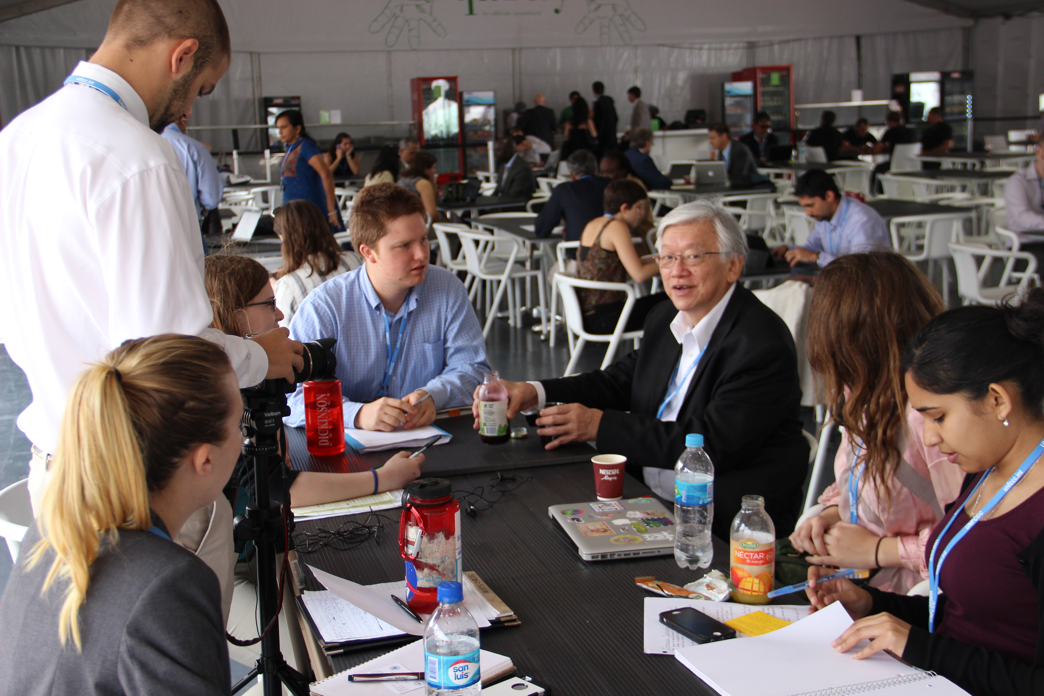
Dickinson students interview Martin Khor, Executive Director, South Centre

Slide 16
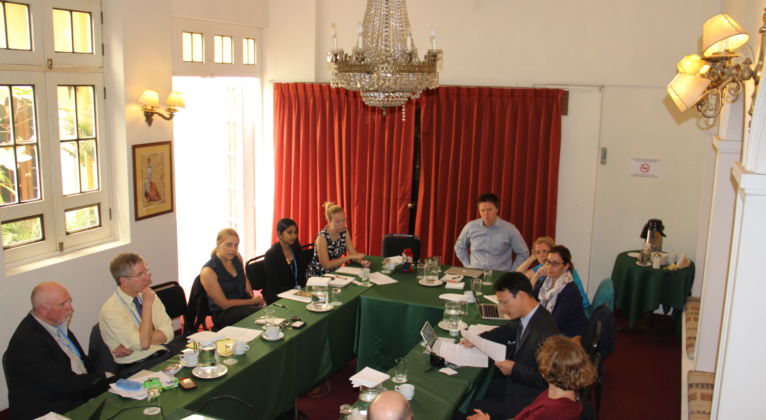
Climate Change & Ethics, PERC & Widener University event, Lima, Peru

Slide 17
Our Blog: blogs.dickinson.edu/cop20

